Slide 1
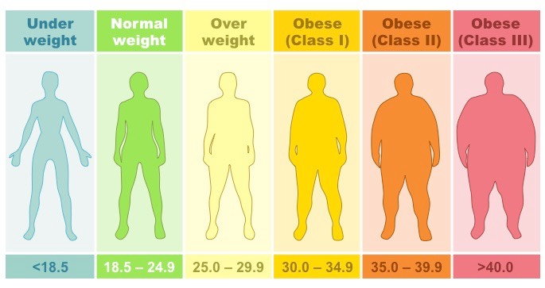
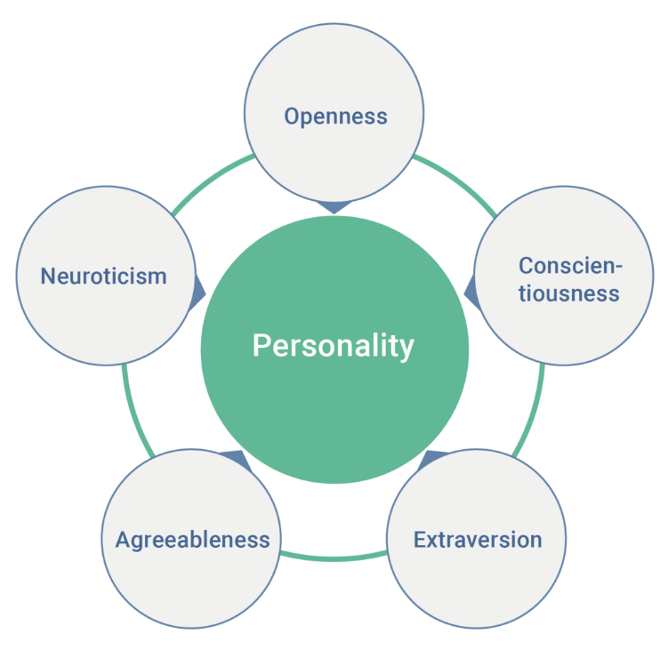
Personality, Weight Loss and Obesity Related Wellbeing Post Bariatric Surgery
Marie L. Caltabiano & Madeline Martin
HYPOTHESES
Those participants high on extraversion would have higher obesity-related quality of life post bariatric surgery compared to those low on extraversion.
Those participants high on neuroticism would have lower obesity-related quality of life post-surgery compared to those low on neuroticism
Exploratory hypothesis:
Those who have elected to have surgery will differ from those not having surgery on neuroticism
and extraversion.
Obesity and Bariatric Surgery
Obesity is defined as having a BMI ≥ 30
Worldwide it is estimated that there are 1.9 billion adults who are overweight and 650 million who are obese (WHO, 2017)
2 in 3 or 63% of Australian adults are overweight or obese (AIHW, 2018).
Excess body weight has been linked with increased risk of mortality and morbidity from heart and vascular diseases (coronary heart disease, stroke, and heart failure) diabetes, gestational diabetes and some cancers (AIHW, 2018).
Traditionally obese and morbidly obese individuals respond poorly to weight loss regimes that involve diet and exercise (Laurino Neto & Herbella, 2013).
Bariatric surgery refers to the group of surgical interventions applied for weight loss.
There are four types of bariatric surgery;
Laparoscopic adjustable gastric banding (GB),
Sleeve gastrectomy
Roux-en-Y gastric bypass (RYGB),
Duodenal switch with biliopancreatic diversion(AIHW, 2017).
Weight loss is achieved through these interventions by various methods of stomach reduction that in turn reduce hunger drive and the individual’s ability to consume large portions of food.
According to the International Federation for the Surgery of Obesity and Metabolic Diseases (IFSO) the total number of bariatric procedures performed worldwide in 2013 was 468,609 (Angrisani et al., 2015).
22,700 weight loss surgeries were performed in Australia in 2014-15
Personality and Obesity
The five-factor model of personality consists of Neuroticism, Extroversion, Openness to experience, Agreeableness and Conscientiousness (Costa & McCrae, 1980)
The traits within the Five-Factor Model (FFM) of Personality have been linked to health outcomes and behaviours across many studies (Friedman, 2008; Goodwin & Friedman, 2006; Ozer & Benet-Martínez, 2006).
Personality traits are defined by cognitive, emotional, and behavioural patterns that likely contribute to unhealthy weight and difficulties with weight management (Sutin, Ferrucci, Zonderman, & Terracciano, 2011).
Personality traits contribute to health outcomes, such as obesity through their association with major controllable risk factors (Provencher et al, 2008; Sutin, Ferrucci, Zonderman & Terracciano, 2011; Terracciano et al, 2009).
Findings on the relationship between personality and weight loss are inconclusive and mixed (Elfhag & Rössner, 2005; Van Hout et al., 2005).
A 50 year longitudinal study of how personality traits are associated with fluctuations in body mass index revealed that participants higher on Neuroticism or Extraversion or lower on Conscientiousness had higher BMI and were more likely to go through cycles of gaining and losing weight throughout their lives (Sutin et al., 2011).
The personality factor, neuroticism has been linked to successful weight loss (Munro, Bore, Munro & Garg, 2008).
Neuroticism
I…
Get stressed out easily.
Am relaxed most of the time.
Worry about things.
Seldom feel blue.
Am easily disturbed.
Get upset easily.
Change my mood a lot.
Have frequent mood swings.
Get irritated easily.
Often feel blue.
Extraversion
I…
Am quite around strangers.
Don’t mind being the center of attention.
Don’t like to draw attention to myself.
Talk to a lot of different people at parties.
Have little to say.
Start conversations.
Keep in the background.
Feel comfortable around people.
Don’t talk a lot.
Am the life of the party.
Bariatric surgery and well-being
After Bariatric surgery most patients report a greater improvement in psychosocial functioning and quality of life (Laurino Neto & Herbella, 2013). The benefits of this weight loss surgery have been recognised around the world, allowing for the dramatic increase in the demand for bariatric surgery.
Improvements in well-being from baseline to post-surgery are reported regardless of type of surgery (Biter, van Buuren, Mannaerts, Apers, Dunkelgrun, & Vijgen, 2017; Porta, Aiolfi, Musolino, Antonini, Zappa, 2017).
Percent weight loss is positively correlated with well-being at 24 months post bariatric surgery Monpellier, Antoniou, Aarts, Janssen & Jansen, 2017).
Method
Participants
The total sample consisted of 381 (359 females and 22 males) with an average age of 43.2 years. Mean BMI change 12.12 (sd=6.61); Mean heaviest BMI=47 (sd=9.2); Mean current BMI=36 (sd=2.7). 42.8% had received the vertical sleeve, 11.4% gastric bypass and 8.5% the gastric band.
Measures
International Personality Item Pool (IPIP) is a measure of the Five-Factor Model (Goldberg et al., 2006). The scale consists of 50 items on a five point Likert scale ranging from Very Inaccurate (1) to Very Accurate (5). The domains show a high correlation (0.85 – 0.92) to Costa and McCrae’s (1992) the revised NEO personality inventory (NERO-PI-R) (Buchanan, Johnson & Goldberg, 2005). The current study found an acceptable Cronbrach’s Alpha level ranging from 0.75 to 0.88.
Orwell 97 - The Obesity Related Well-Being scale is a self-reported measure of obesity-related Quality of Life. The questionnaire considers both the intensity and subjective relevance of physical and psychosocial distress (Mannucci et al.,1999). There are 18 questions consisting of two parts. It uses a 4-point Likert scale ranging from not at all (0) to much (3). Quality of life is determined by the participants’ response to questions that determine occurrence of the symptoms (O:occurrence) and the relevance of said symptoms on their lives (R:relevance). The sum of these responses, occurrence and relevance, provides a score on the ORWELL 97 scale, the higher the result the lower the quality of life (Mannucci et al.,1999).
Sample item
R: Do you have a negative opinion of yourself?
O: Does being overweight interfere with your opinion of yourself?
Results
Table 1
Mean differences on well-being (Orwell 97) for those low versus high on Neuroticism and Extraversion
There were no significant differences between those low versus high on neuroticism or extraversion, on BMI change.
Those electing bariatric surgery did not differ from those who did not have surgery on either neuroticism or extraversion.
Neuroticism | M | SD | t-test | p
Low | 55.9 | 17.56 | t₍₂₈₆₎=6.39 | 0.00
High | 39.3 | 12.7
Extraversion
Low | 53.8 | 18.2 | T₍₂₈₇₎=1.68 | ns
High | 49.3 | 16.2
Correlations
A Pearson product-moment correlation coefficient was computed to assess the relationship between Neuroticism scores and Orwell97 scores. There was a negative moderate-significant correlation between the two variables, r= -.481, n=289, p=0.00. The relationship between extraversion scores and total Orwell97 scores was negative and weak, r(303)= -.181, n =289, p = 0.002.
Discussion
Participants who had surgery and exhibit extraversion traits were more likely to have a better quality of life as measured by the Orwell97. According to Costa and McCrae (1980) extroverted individuals are more adjusted, maintain broader social networks and are happier than people who fall into the other personality traits. Extroverted traits help contribute to the individuals’ positive enjoyment and satisfaction in all aspects of life (Costa & McCrae, 1980).
Those low on neuroticism had higher scores on the Orwell97 or lower well-being.
Conclusion
By understanding the relationship between personality, obesity related quality of life, and weight loss, bariatric surgery intervention programs can be designed and implemented to suit different personality types to help maintain weight loss. More research is needed in this area to help determine whether personality traits can be used as an indicator of individuals’ success after bariatric surgery.
References: Angrisani, L., Santonicola, A., Lovino, P., Formisano, G., Buchwald, H., & Scopinaro,N.(2015). Bariatric surgery worldwide 2013. Obesity Surgery, 25(10), 1822-1832. doi: 10.1007/s11695-015-1657-z, Australian Institute of Health and Welfare. Weight loss surgery in Australia 2014–15: Australian hospital statistics Cat. no. HSE 186.Canberra: AIHW; 2017.AIHW (2018) Overweight and obesity. Accessed online on 28th Nov, 2018, at https://www.aihw.gov.au/reports-data/behaviours-risk-factors/overweight-obesity/overviewBiter, L.U., van Buuren, M.M., Mannaerts, G.H., Apers, J.A., Dunkelgrun, M., & Vijgen,G.H., (2017). Quality of life 1 year after laparoscopic sleeve gastrectomy versus laparoscopic roux-en-Y gastric bypass: a randomized controlled trial focusing on gastroesophageal reflux disease. Obesity Surgery, 27; 2557-2565.Costa, PT Jr., & McCrae, R. (1980). Influence of extraversion and neuroticism on subjective well-being: Happy and unhappy people. Journal of Personality and Social Psychology, 38(4), 668-678.Elfhag, K, & Rossner, S. (2005). Who succeeds in maintaining weight loss? A conceptual review of factors associated with weight loss maintenance and weight regain. Obesity Reviews, 6(1), 67-85.Friedman, H. (2008). The multiple linkages of personality and disease. Brain, Behaviour and Immunity, 22(5), 668-675.Goodwin, R., & Friedman, H. (2006). Health status and the five-factor personality traits in a nationally representative sample. Journal of Health Psychology, 11(5), 643-654.Laurino Neto, R., & Herbella, M. (2013). Changes in quality of life after short and long term follow-up of roux-en-y gastric bypass for morbid obesity. Arquivos de astroenterologia, 50(3), 168-190.McCrae RR, Costa PT (January 1987). "Validation of the five-factor model of personality across instruments and observers". Journal of Personality and Social Psychology. 52 (1): 81–90. doi:10.1037/0022-3514.52.1.81. Monpellier, V.M., Antoniou, E.E., Aarts, E.O., Janssen, I.M., & Jansen, A.T., (2017).Improvement of health-related quality of life after Roux-en-Y Gastric bypass related with weight loss. Obesity Surgery, 27, 1168-1173.Munro, I., Bore, M., Munro, D., & Garg, M. (2011). Using personality as a predictor of diet induced weight loss and weight management. International Journal of Behavioural Nutrition and Physical Activity, 8, 129-134. Ozer, D., & Benet-Martínez, V. (2006). Personality and the prediction of consequential outcomes. Annual Review of Psychology, 57, 401-421.Porta, A., Aiolfi, A., Musolino, C., Antonini, I., Zappa, M.A. (2017). Prospective comparison and quality of life for single-incision and conventional laparoscopic sleeve gastrectomy in a series of morbidly obese patients. Obesity Surgery, 27, 681-687. Provencher, V., Bégin, C., Gagnon-Girouard, M., Tremblay, A., Boivin, S., & Lemieux, S. (2008). Personality traits in overweight and obese women: Associations with BMI and eating behaviours. Eating Behaviours, 9(3), 294-302Sutin, A., Ferrucci, L., Zonderman, A., & Terracciano, A. (2011). Personality and obesity across the adult life span. Journal of Personality and Social Psychology, 101(3), 579-592. Terracciano, A., Sutin, A., McCrae, R., Deiana, B., Ferrucci, L., Schlessinger, D., Uda, M., & Costa, P. Jr. (2009). Facets of personality linked to underweight and overweight. Psychosomatic Medicine, 71(6), 682-689. doi: 10.1097/PSY.0b013e3181a2925b.VanHout, G., Verschure, S., & VanHeck, G. (2005). Psychosocial predictors of success following bariatric surgery. Obesity Surgery, 15(4), 552-560.World Health Organisation. (2016). Risk factors. Retrieved from http://www.who.int/gho/ncd/risk_factors
Ristanto Poster Designs

