Slide 1
Psychological counseling benefits well-being post bariatric surgery
Ashley Ristanto
&
Associate Professor Marie L. Caltabiano

Slide 2
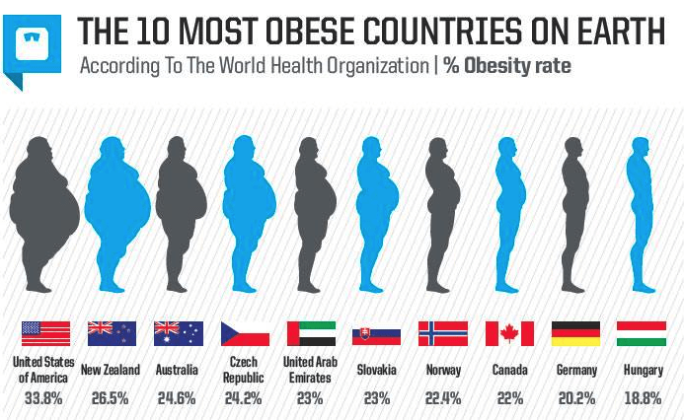
Psychological Issues
Obesity Rates
Worldwide it is estimated that there
are 1.9 billion adults who are overweight & 650 million who are obese; Obesity - BMI (kg/m²) ≥ 30
Lower quality of life
Pre-operative depression & anxiety
Unrealistic expectations
Previous issues with disordered eating
Bariatric Surgery and Weight loss
In the first year following surgery patients lose up to 30% of their weight (Miras et.al 2014)
8 years post surgery 12% had a BMI > 40 (Kruseman et al., 2010)
Weight re-gain is associated with clinical depression (Burgmer et al., 2014)
Post-operative follow-up of >6 sessions associated with weight loss success (Shen et al., 2004)

Slide 3
Methodology
This Research
Background – Obesity rates, Bariatric surgery success rates and long term wellbeing scores using the SF12 measure
Aim – Does psychological counselling post surgery benefit wellbeing compared to no counselling?
Hypothesis – Patients who received 6 or more counselling sessions will have better psychological and physical well-being.
Online Survey
SF12 (mental & physical well-being); number of psychological counselling sessions, type of surgery, BMI
Bariatric support groups
Total participants – 88
Mean age - 43 years ; mean BMI = 33.43
Results
Participants who attended up to 4 counseling sessions had a higher Mental Health Component score than the group who had attended no sessions. (M=49.02,SD=6.12) scores of 4.28, 95%CI(-7.47,-1.08)higher than the group with no counseling intervention (M=44.74, SD=6.44), t (70)= -2.67,p<.05, .009 two tailed, d=6.34.

Slide 4
Discussion
Hypothesis that 6 or more psychological counselling sessions would benefit the mental wellbeing of the individual was not supported
Between 1 and 4 sessions increased mental health scores.
Limitations
Implications and Future Directions
Counseling post surgery may assist in long-term wellbeing and weight-loss maintenance
Specific Programs can be tailored to the needs of Bariatric patients
Time since surgery needs to be incorporated
Type of counselling needs to be addressed
More participants

