Slide 1
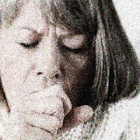
‘No coughing for me, but I’m okay!’ Mapping a human service workers’ body stories as she engages with traumatised women in a domestic violence service.
Jo Mensinga
School of Arts and Social Science James Cook University, P O Box 6811 Cairns Qld 4870

Slide 2
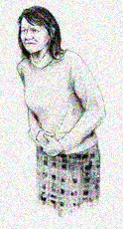
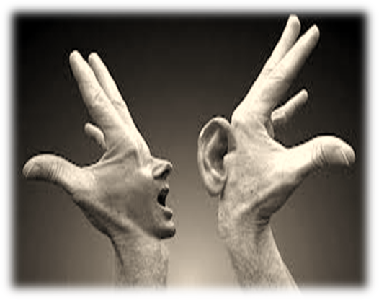
My interest as a researcher is to listen to and make space for the body in practice
Social worker
– 15 years
Academic
– 19 years
Yoga practitioner
– 40+ years
Librariancarina.blogspot.com
… while the body is inarticulate, it is not mute… (Frank, 1995, p.27)
digestive.niddk.nih.gov
Notes:
Focus on client outcomes and the evidence based practice discourse has reached new heights
This approach is largely underpinned by a reductionist/positivist epistemology that relies on an acceptance of a mind-body split.
I argue that the body, as subject, needs to be recognized and accounted for in professional practice

Slide 3
What’s ahead:
Relational, body-oriented and brain-based approaches to recovery and change becoming increasingly popular BUT little in the literature to describe how practitioners navigate own somatic maps in the process
PhD research project (2010-11) – In depth interviews exploring stories about human service workers’ experiences of the body in their own professional practice.
Coral’s stories of how she navigates her own somatic map as she interacts with traumatised women and workers in a domestic violence service.

Slide 4
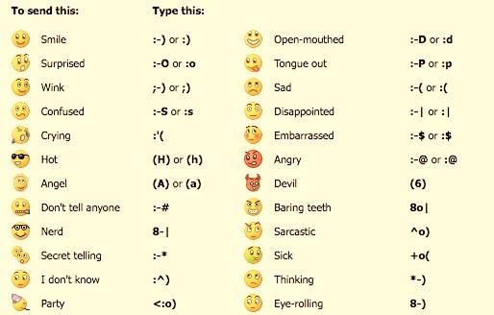
What does it feel like to be a human service worker?
What does this feeling look like in your body?
(photaki.com)
(cool-smileys.com)

Slide 5
How would your feeling impact your ‘clients’ and/or your colleagues’ experience?
In pairs….
Take turns talking to each other while in the
position you chose
Discuss what effect you think this had or would
have on others
Did you expect this? Why? Why not?

Slide 6
Questions to ponder…
Would you have learnt the same things if I had just asked you to talk about the impact of the body in your work?
Why?
Why not?
“You see, now, while I am talking to you, I can feel the ends of my toes. Isn’t that an amazing thing?”
(Pagis, 2009)

Slide 7
Background - Little about the body in social work literature…
Bookriot.com
Femme-fatale.com

Slide 8
Cameron and McDermott, 2007
The physiological body is addressed minimally
Difficult to define the body – physiology vs. socially constructed definitions
Injustices have occurred on the basis of body – e.g., gender, race, genetic research
The reductionist nature of biological sciences

Slide 9
Tangenberg & Kemp, 2002
Just as bodies are inscribed with greater and lesser degrees of perceived power on the basis of race and ethnicity, age, gender, and (dis)ability, so the value of knowledge from the body reflects the social power associated with the individual: more powerful individuals define what knowledge is accepted and embodied by social institutions. (p.15)

Slide 10
I argue that we need to understand practitioner’s somatic map to distinguish between habit and what is experienced in the room → particularly in relation to social workers (Mensinga, 2011)
We Need to….
Listen to existing stories → what strategies and power structures support or discourage exploring the body in the professional conversation, to bring about change (Frank, 2010; Plummer, 1995)
Notes:
Need to:
Understand practitioner’s somatic map to distinguish between habitual responses & what is experienced in the liminal space between the worker and others while they navigate community, agency and consumers’ physical spaces (Mensinga, 2011)
Listen to existing stories told by social workers about and by their bodies in the sector to better understand what strategies and power structures may support or discourage the telling of these stories in the professional conversation (Frank, 2010; Plummer, 1995)

Slide 11
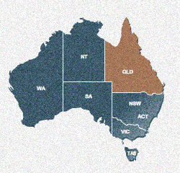
Coral - Part of a larger research project undertaken in 2010-11
North Queensland
http://www.surfinaustralia.com.au

Slide 12
Part of my PhD study - participants
1of 9 human service workers interviewed (6 = social workers)
Part of a focus group of 5 women that was interviewed on 3 occasions (in North Queensland, Australia)
1 of 6 women (from North Queensland X 3, Central Queensland X 1, New South Wales X 1 and in the United States X 1) who were interviewed individually either once (Coral and 2 others) or 3 times (X3)

Slide 13
Methodology
Feminist, post-structural, NARRATIVE approach … useful for exploring the complexity and diversity of life systems, particularly in facilitating an understanding of the intersection between culture, person and change
‘… requires close reading of contexts, including the influence of the investigator, setting, and social circumstances of the production and interpretation of narrative.’ (Riessman, 2008:105)
IN-DEPTH INTERVIEWS

Slide 14
Bachelor of Arts (Human Services)
Youngest participant (34)
NGO focusing on Domestic violence (Feminist philosophy)
Uses Body as a source of knowledge and an intervention tool
Uses practice of mindfulness and co-regulation with clients
No ‘body practice’ of her own, but familiar with yoga
C
O
R
A
L

Slide 15
CONTEXT…
EXPERIENCE OF HER OWN BODY…
LEARNT ABOUT THE BODY…
Alright to use embodied practices in counselling room but not in other areas of the sector –manager is uncomfortable [Focus group 1]
The meaning of her own weight/body size – standing ground vs. eating feelings [Individual Interview]
When working, feels things in the gut [Individual Interview]
Learnt about emotional regulation in the tourism industry - attunement vs. disassociation [Individual interview]
Highlighted workers’ reluctance to participate in role plays - doing is more revealing than talking [Focus group 1]
Explored the difference between role plays and being observed in the counselling room - judging and thinking [Focus group 1]
Coral’s stories

Slide 16
USING THE BODY AT WORK…
Coughing fit, tickle in the throat – something is stuck [Individual interview]
Other workers work differently – grounding vs. energies/spiritual underpinnings [Individual interview]
Bodies talking to bodies… victims cf. perpetrators cf. police prosecutors [Individual interview]
Reframing clients’ body stories as acts of resistance [Individual interview]
Stories I focus on
today
Coral’s stories

Slide 17
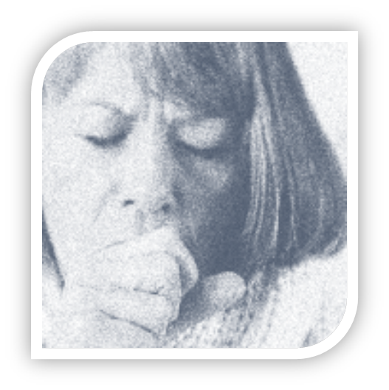
‘No coughing for me, but I’m okay!’

Slide 18
OBSERVATION :
What I have noticed is that there are some other workers who work differently, and that’s fine because we all work differently and everything works for different reasons, but some are really affected by that energy, and you know sometimes even there have been workers who will find themselves coughing lots or going into coughing fits. Or they will get that tickle in their throat when they have got someone who has got an energy that is really draining. Especially adult clients who find no hope and feel completely powerless and can’t see a way out to navigate that or find one shred of hope. And it’s interesting because there has been a couple of workers who do find that they do get choked up or they will have the coughing fit and they have attributed that to the energy of the client. And I wonder if I don’t know whether it is am I too hard line or is it that other workers are more affected and I just don’t know why that is whether that is about there own resilience or their own self care…
Notes:
J –I mean it has been some time since we have talked have you thought anymore about the body did anything trigger?
I have been looking at how other practitioners in our service work and then I look at how I work and how energies and such affect me or don’t affect me and how it might impact on other people and it that has got me a little bit curious, I wonder ‘is it me, who is odd?’ .
I have doing the work for six years so you know I try to check in fairly regularly to make sure that I have not become too disconnected or too hardened to the stories, because I think there is always a danger of that and I try to be very aware. I would like to think that I haven’t become hardened.
I think it is interesting when new workers come in because they often go ‘ahh’ like every story they hear is really extreme, and he’s incredibly dangerous. And actually it’s not that extreme and unfortunately it is a reasonably standard issue. But I try to be very careful not be become complacent because that is very dangerous.
I have also sort of been looking at how I might use my body in sessions, like when I am being attentive and when I am listening and that kind of stuff. I probably think one of the biggest tools I use in that is actually my voice more so than anything else and how I may moderate that voice to try and keep things as calm as possible ,because I can’t be in place of chaos, when someone is coming out of chaos trying to deal with that crisis that kind of stuff.
But I have been looking at little bit of my body language and what does that look like and how do I attend to my client’s needs, and whether that impacts on their energy or not and how they, it’s that co regulation stuff. I probably use co regulation quite a lot, quite strongly.
It’s very unusual for me to go into someone’s space and it is usually only if it is with a client that I know and know well and then its touches to the forearm to get them to centre and actually be really present. Because one of the things that we see happens so often is that disassociation, you can literally see your client go somewhere else in their head and sometimes it is about bringing them back to the present so that brief touch on the forearm or I might move a bit closer and maintain my eye contact and try and bring them back into the present.
I haven’t reflected too much on how that work affects me and my body, except for the fact that I am really short, and my posture most of the time because I tend to lean in and be really attentive when I am listening, you know I end up with a sore back, just because I am at slightly an odd angle because my legs are short and the chair is not necessarily made for how I sit, but that is ok I can just kind of deal with it.
I don’t know that I feel like I carry it in my body and I don’t for the most part I don’t feel like I take on other people’s energies in that co regulation that we sometimes do, but then sometimes energy is a little bit different I think to the co regulation stuff.
……

Slide 19
REFLECTION :
…… having said that they are probably workers that I would consider, and I guess it’s not that I am not spiritual there are aspects of me that are spiritual, but I feel that perhaps a lot more connected to some of the aspects of … probably more connected in almost a yoga like way, when we talk about energies …… and that kind of stuff and for me it’s rare for anything like that to happen … So then I will kind of go ‘aww is that me?’ or ‘is that my problem? is it me?’ or is it that I just tend to just soldier on, because sometimes you just have to. I don’t know whether that’s personality or just you know where I come from, and I don’t feel things, like things don’t weigh me down I tend to kind of go “yeah lets go, that’s fine”. So I think that’s what gets me a little bit concerned whether I am not empathic enough. But the feed back from my clients is always really positive, there is rapport there and warmth there otherwise I think we wouldn’t be having some conversations that we do end up having.
Notes:
And I wonder if I don’t know whether it is am I too hard line or is it that other workers are more affected and I just don’t know why that is whether that is about there own resilience or their own self care, having said that there is not anything that I particularly do actively around self care, except to be very aware that that is not my story, that is their story.
J – So do you have a different understand of co regulation do you think or?
C – Maybe I guess with co regulation part of it for me is about using my energy or my calm to try and bring that with the client.
J – Yes
C – And I guess that is where my tone of voice comes in, in the attentiveness like my body language and my attentiveness to the client is perhaps a little bit different to maybe other workers.
J – Because it is interesting you say you use your voice and you have talked about them coughing and having a tickle in the throat, so is that indicative of something.
C – Yeah maybe I use my voice differently to how they use theirs.
J – Differently, yeah.
C – And that co regulation works on a slightly different way, I don’t quite know, but it has made me a bit curious and like I said I have been doing it for six years so I try to do very regular check ins with myself, and I am not just being a hard ass essentially.

Slide 20
CONCLUSION :
J – So do you discuss bodies from that point of view, or body reactions or…
C – A little bit and I guess it’s been more of a discussion where the other workers have gone ‘oh yes I dealt with that client’ and I guess one of the examples was a child counsellor spoke to a particular client and one of the other adult counsellors spoke to the same client and they both had that reaction to that client, and so they were kind of going ‘ohh, I know, the energy!’ and ‘rah, rah’, and I was kind of going ‘No coughing fit for me, but I’m ok’… um so I think it has probably come up in that … and I am glad that it is a safe enough workplace that people can do that and they can feel comfortable talking about it and doing those things and not feel too awkward … they might feel a little bit awkward because of how the manager is because she is so like ‘you are doing what?’.
[Coral, 10/11/2011]
Notes:
No coughing fit for me but I am ok’. , um so I think it has probably come up in that, I like that it is a safe enough space for workers to also talk in that way where they are talking about the energies and you know there is another worker who has a special kind of herbal blend that she sprays to help clean her spiritual energy after clients and that kind of stuff, and I am glad that it is a safe enough workplace that people can do that and they can feel comfortable talking about it and doing those things and not feel too awkward, I think every now and then they might feel a little bit awkward because of how the manager it’s because she is so like you are doing what? Ok but you can kind of see her going uh hu, good luck with that.
J – Get on with it and go if it works.
C – Yeah as managers often do, but you know it is obviously relatively safe for them to at least have those discussions and to put into practice some of those things that help them take care of themselves which is going to be the most important thing, because if they are not doing self-care it really takes a toll, and I always sometimes you will have workers who are there for a year or so and they are already starting to kind of go I am getting burnt out and rah, rah, rah and I just need and I have not got to that place yet, I have had times where I have cried, but I have not got to that place where I can’t bear the thought of getting up and going to work.
J – Six years is a long time what has helped you do that.
C – Yeah, I do not know, because that is the other thing that I kind of go well what is that about that capacity and I guess that is where I get concerned am I so disconnected from this stuff that it does not affect me, and it is not that there is not days where I am not affected, like I have had days where I have gone into my manager and I have cried, usually those tears are out of frustration or they are out of grief because a client of mine suicided

Slide 21
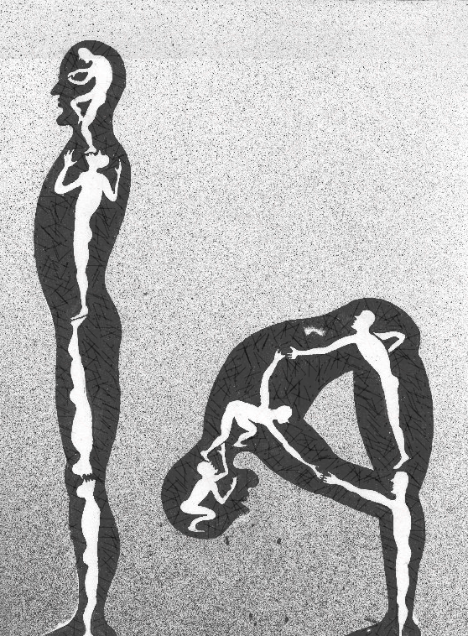
Exploring and learning from Coral’s body stories

Slide 22
Shaw (2004) - study of how psychotherapists used their bodies
Psychotherapists experienced:
‘Body as receiver’ - feels the felt experience of the client
‘Body empathy’ - own experience as a consequence of participating in the session (a sense of ‘tuning into’ the client )
Need to shared with the client to create a mutually co-constructed narrative - therapist’s bodily experience must arise from the therapist’s body, not the client’s
Coral:
Throat issues that workers experience = taking on the client’s felt experience rather than ‘energy’, the client’s feeling of not being able to say what they want to say – i.e., ‘the body as receiver’.
Notes:
- ‘Body as receiver’ - a passive process in which the therapist has little choice in feeling the felt experience of the client
- ‘Body empathy’ /a sense of ‘tuning into’ the client - a more active process in which the therapist purposely acknowledges their own experience as a consequence of participating in the session
- needs to ‘be shared with the client in a way that allows the therapeutic endeavour to be a mutually co-constructed narrative, since the therapist’s bodily experience must arise from the therapist’s body, not the client’s’ (p. 84).

Slide 23
Frank asks ‘How does Coral’s story serve us?’ (2012)
Narrative resources? – provides opportunity to review the significance of a cough, energy of client, felt experience
Who can the stories be told to and why? – the client so as to co-construct new story and therapist can identify own feeling, other workers in the agency to ‘improve practice’, but not the manager
Who is accepted/prevented being a group member by understanding the story? – workers who are willing to explore the body subjectively, - clients (?) , managers & workers in larger sector
How does the story encourage people to be who they are? – acknowledges the impact of bodies on/in the helping process and provides example of how listening to bodies can provide an alternate explanation and prevent ‘burnout in the worker
How does the story teller maintain their social standing/positioning telling the story in the way they did? – Coral adopts a reflective approach (professionally sound) and highlights being curious as important to the process
Notes:
Could look at content ONLY, but am interested in more than this…. How do stories serve the teller?
Frank Suggests the following questions to help explore and better understand the stories told

Slide 24
Conclusion:
….the body, as subject, needs to be recognized and accounted for in professional practice and joy found in the stories we share about what we feel in our bodies during practice encounters… provides a much richer account of our practice
‘How social work practice is generally written and talked about lacks atmosphere, as it largely fails to capture the texture, feel, the lived experiences of where the work goes on and how this impacts on perception and what does (and does not) get done.’ (Ferguson, 2010:3)

