Slide 1
Could you listen to me?
Suicidal attempts in children
Dr Stanganelli, V, NP Gingell, M; Ph. Hansen ,B; Ph. Heywood, A; Ph. Zelenka,B; Ph. Spillman, S; SW Sutton; SW Howe, A; SW France, N. Mackay, Australia 2016.
RANZCP Congress, Hong Honk, 2016.

Slide 2
Could you listen to me?
Background
Suicidal attempts in children under 12 years old are rare
Specific data are relatively scarce and inconsistent
They are clinically different from youth suicide
Engage in concrete operational thinking
Rigid cognitive patterns and limited problem solving
Pfeffer et al.(1) point out the essential quality of suicidality is the intent to cause self-injury or death, regardless of the cognitive ability to understand finality, lethality or outcomes

Slide 3
Could you listen to me?
Pre-pubertal children who have attempted suicide previously may be up to six times more likely to attempt suicide in adolescence, increasing lethality with age.(2)
Bullying at home, school and cyber-bullying increase peer pressure, poor performance, loneliness, hopelessness.
Family constellations with neglect or abuse are risk factors in children suicidal attempts
Losses in childhood, guilt and blame, retaliation, revenge, avoiding punishment, identification with depressed or suicidal parents are frequent causes in these patients

Slide 4
Could you listen to me?
Methods
Mackay has 21% population aged 0-14 years old
We had 31 admissions for suicidal gestures between 0-12 years old over the past 10 years
An interdisciplinary team assessed them with continuity outpatient care
Crisis intervention plan and suicidal prevention were successfully implemented

Slide 5
10-year-retrospective analysis: 31 Admissions
Could you listen to me?

Slide 6
10-year-restrospective analysis
Could you listen to me?

Slide 7
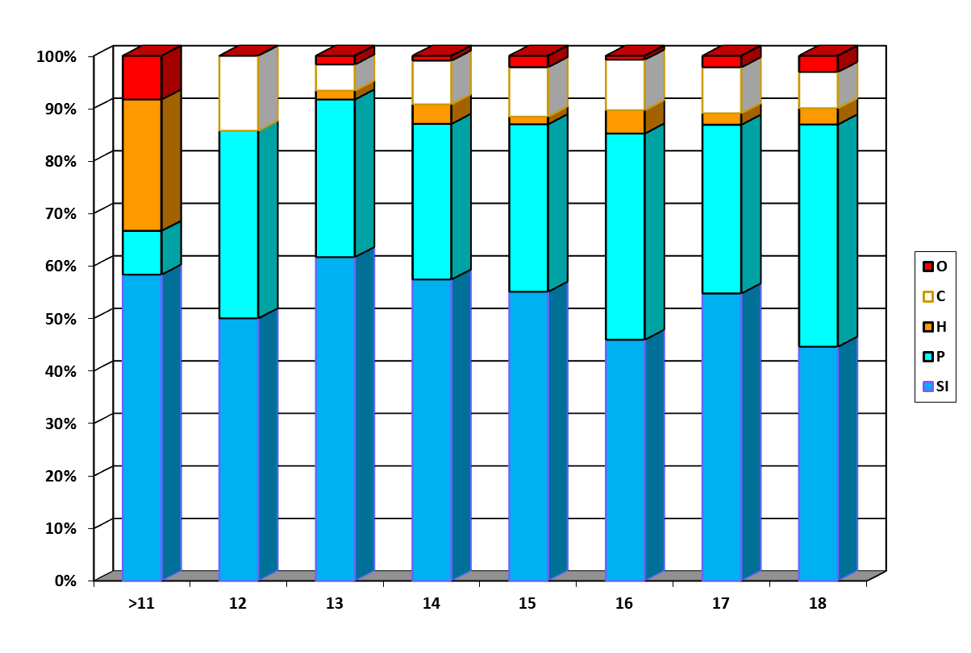
Method/age N: 31 admission < 12 years old.
Could you listen to me?

Slide 8
10-year-restrospective analysis : MDD(F32.2)
Could you listen to me?

Slide 9
10-year-restrospective analysis : SUBSTANCE ABUSE(F10/12)
Could you listen to me?

Slide 10
10-year-restrospective analysis : ATTACHMENT DISORDER(F94.1)
Could you listen to me?

Slide 11
10-year-restrospective analysis : ADHD/ASD/CD (F90.0/F84.5/F91.0)
Could you listen to me?

Slide 12
10-year-restrospective analysis : BULLYING
Could you listen to me?

Slide 13
10-year-restrospective analysis : DOMESTIC VIOLENCE
Could you listen to me?

Slide 14
10-year-restrospective analysis : PARENTS
Could you listen to me?

Slide 15
10-year-retrospective analysis: 31 Admissions/Parents
Could you listen to me?

Slide 16
Could you listen to me?
Risk factors:
More common in boys
Depression in girls increase risk
Disruptive behaviours/ASD/ADHD in boys increase risk
Identification with a depressed/dead/suicidal parent
History of bullying at school and DV at home
Common method hanging or other under 12 years old
100% Reactive attachment disorder as secondary diagnosis
100% parents with severe mental illnesses

Slide 17
Could you listen to me?
Attachment based family therapy (ABFT) has been found to be effective in reducing suicidal ideation in young people( Diamond et al, 2010)
The family is the most important developmental and protective factor in childhood
The goal is to strengthen families
From attachment perspective: children internalize beliefs about self and expectations of others through early attachment relationships as internal working models
Attachment theory proposes a life span attachment model

Slide 18
Could you listen to me?
ATTACHMENT BASED FAMILY THERAPY
It is a brief 16 weeks treatment
Aims to re-establish safety, protection and availability
It is an experiential context to learn
New communication skills
Affect regulation skills
Interpersonal problem solving skills

Slide 19
Could you listen to me?
ATTACHMENT BASED FAMILY THERAPY
Relational re frame
Alliance with the adolescent
Alliance with the parent
Reattachment task
Promoting competency task
(87% recover from the symptoms)(4)

Slide 20
Could you listen to me?
CONCLUSIONS
Understanding suicidality among children requires listening to their intent and meaning of death, despite of their inability to recognize lethality and outcomes.
Family dynamics need to be unfolded and attachment based-family therapy seemed to have favourable results in these cases but in the context of an entire community compromise.

Slide 21

“It takes a whole village to raise a child”

Slide 22
References
Pfeffer CR. Suicidal behaviours in children: from the 1980s to the new millennium
Review of suicidology, NY: Guilford, 2000 pp. 159-69.
Brent et al. Familial transmission of mood disorders: convergence and divergence with transmission of suicidal behaviours. J.Am.Acad.Child Adolesc Psychiatry, 2004;43: 1259-66.
Tishler C et al. Suicidal Behaviour in children younger than twelve: A diagnostic challenge for Emergency Department Personnel. Acad.Emerg.Med.200;14:810-818
Doi:10.1197/j.aem.2007.05.014
Attachment –based Family Therapy . Diamond G, et al. APA video series ISBN 4310925
“ It takes a village: and other lessons children teach us”- H. Clinton, Simon &Schuster, January 1996, ISBN; 1-4165-4064-4

